Slide 1
Science May 11, 2007 (Vol 316)

Slide 2
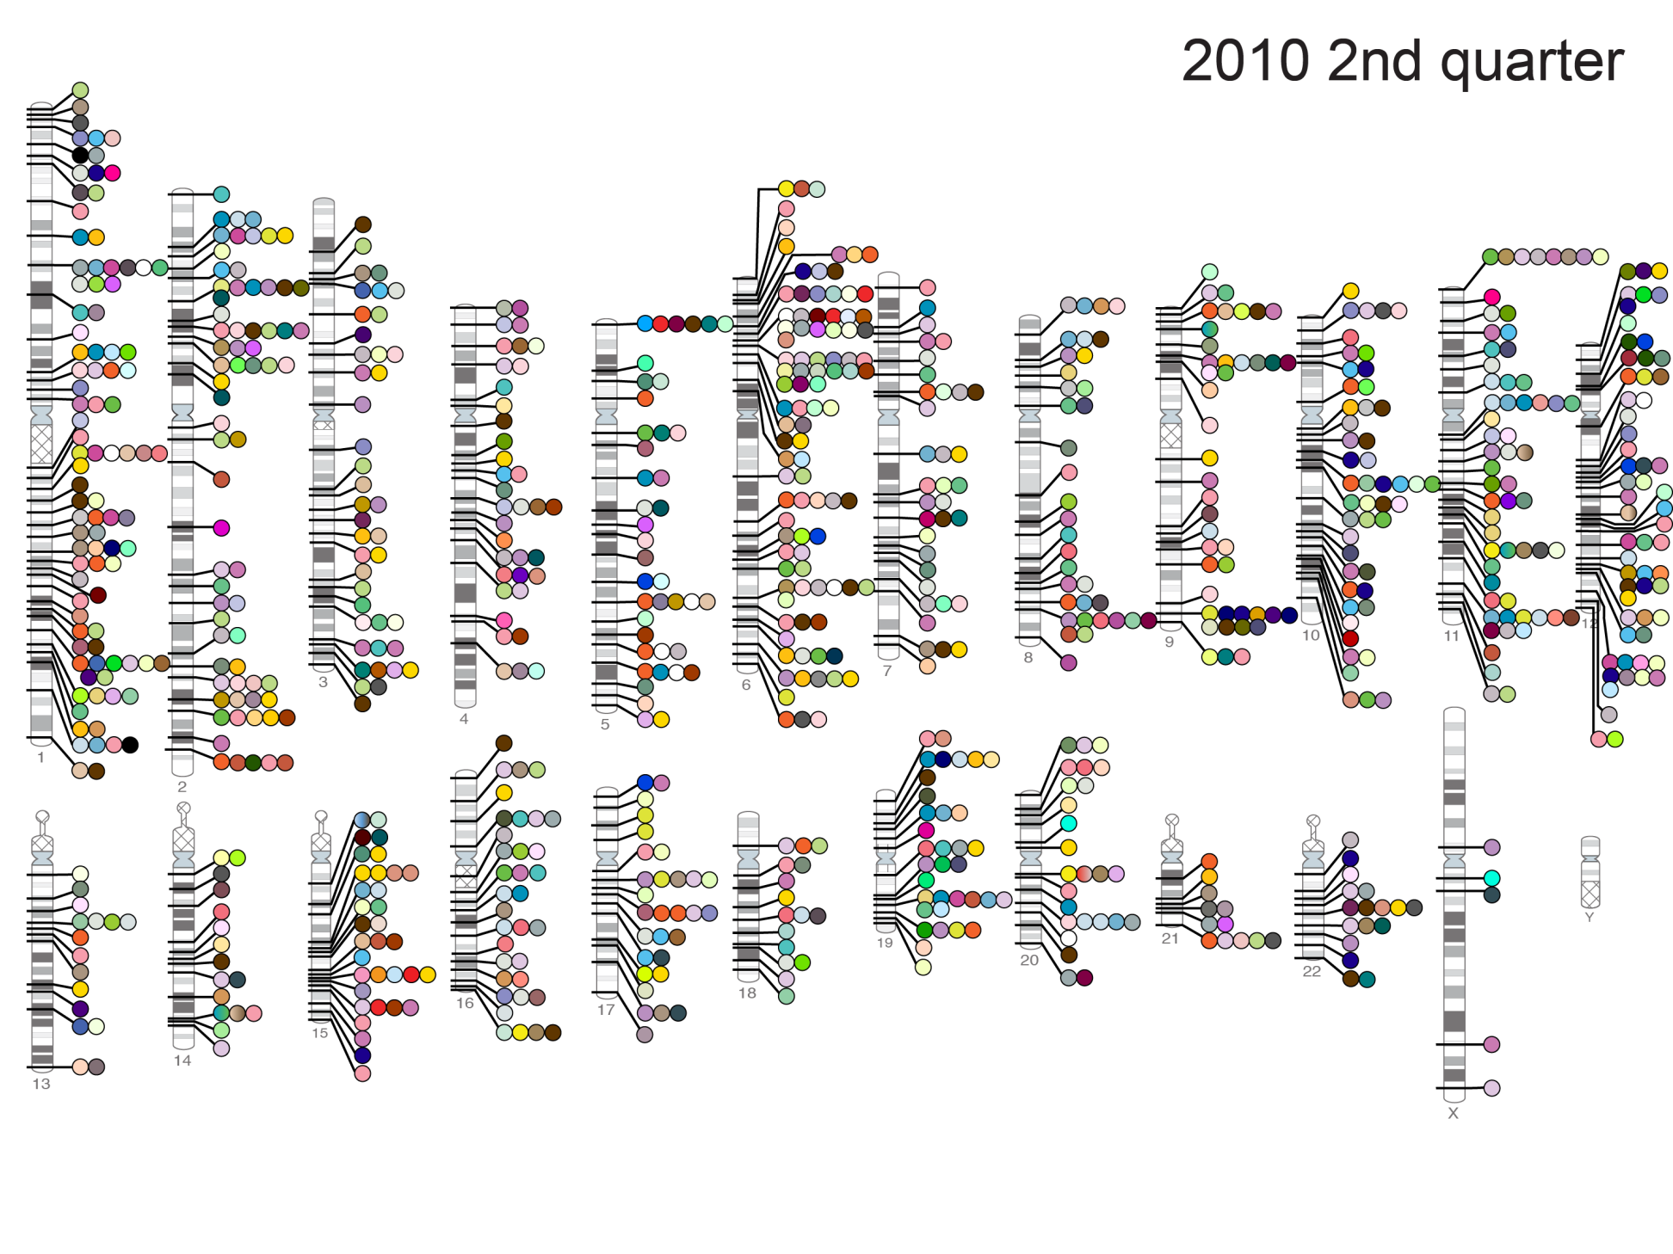
Published Genome-Wide Associations through 6/2010
(904 published GWAS hits at p<5x10⁻⁸ for 165 traits)
Blood Pressure; Coronary Disease; HDL; Heart Rate; LDL; Obesity; Total Cholesterol; T2D
NHGRI GWA Catalog (www.genome.gov/GWAStudies)

Slide 3
2. Global Human Functional Genomic Diversity: Stratification and its Consequences

Slide 4

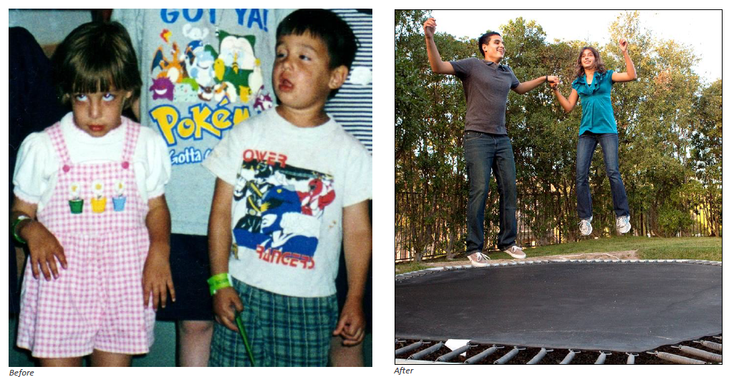
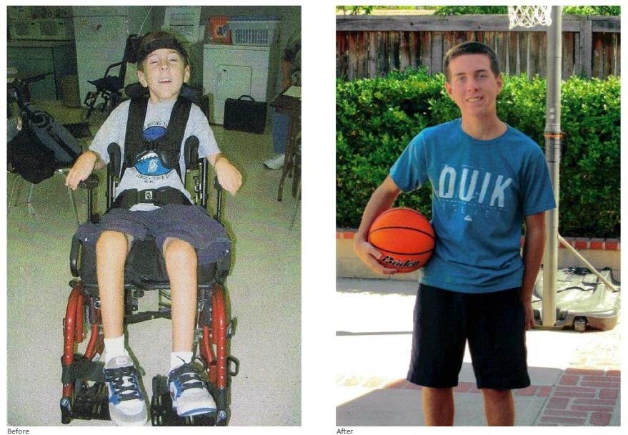
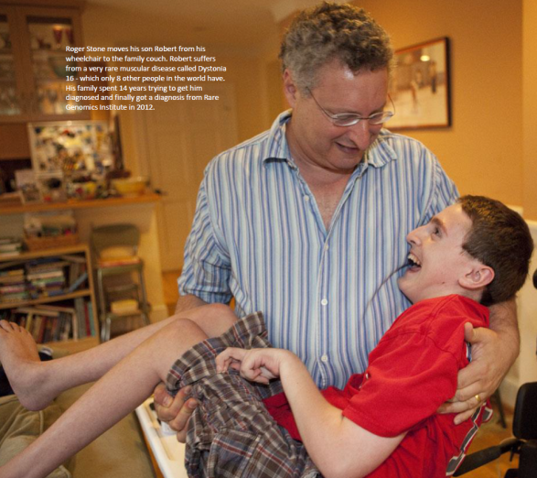
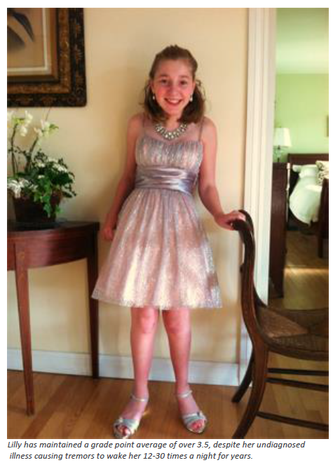
Idiopathic Diseases: Genomics Can Help…
Rare Genomics Institute: www.RareGenomics.org

Slide 5
Finding the Causative Variants for Idiopathic Disease: Filters
Two reasonable(?) assumptions:
The pathogenic variant(s) is ‘novel’ (i.e., unique to the patient)
The effect of the variant is pronounced enough to be characterized bioinformatically since there will be too many variants not functionally characterized via lab experiments
Novel Variant in Functional Element
…C G A T C A…
C G A T C A
1. Novel
2. Damaging
3. Relevant
Pathway
4. No
Compensatory
Mechanism
5. Pathogenic
Patient
Reference
genomes
…ACGCCGTCAGGGTCATAGTAGACTAGCTTGAGCTACCAAA…
…ACGTCGTCAGGGTCATCGTAGACTAGCTAGAGCTAGCATA…
…ACGTCGTCAGGCTCATAGTAGACTAGCTAGAGCTAGCATA…
…ACGTCGTCAGGCTCATAGTAGACTAGCTAGAGCTAGCAAA…
…ACGCCGTCAGGCTCATCGTAGACTAGCTAGAGCTAGCATA…
…ACGTCGTCAGGCTCATAGTAGACTAGCTAGAGCTAGCATA…
…ACGTCGTCAGGCTCATAGTAGACTAGCTAGAGCTAGCATA…
…ACGCCGTCAGGCTCATCGTAGACTAGCTAGAGCTACCATA…
…ACGTCGTCAGGCTCATCGTAGACTAGCTAGAGCTAGCATA…
…ACGCCGTCAGGCTCATAGTAGACTAGCTAGAGCTAGCATA…
…ACGTCGTCAGGCTCATCGTAGACTAGCTAGAGCTAGCAAA…
…ACGTCGTCAGGCTCATCGTAGACTAGCTAGAGCTACCATA…
G A T C
G A T
A T
T
What bioinformatic tools should be used for functionality? Does it make a difference?
What reference populations for determining novelty should be used? Does it matter?

Slide 6
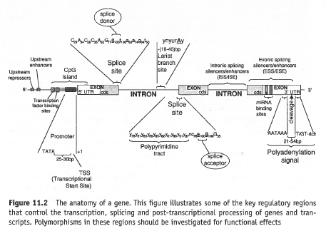
Functional Annotations: Bioinformatic Predictions
Splice Change
Frameshift Structural Variants
Nonsense SNVs
Damaging ns cSNPs
Transcription
Factor Binding
Disrupting
Exonic Splicing
Silencer
Protein Motif Damaging
microRNA
Binding Site
Disrupting
Exonic Splicing
Enhancer
Plumpton and Barnes. “Predictive Functional Analysis of Polymorphisms: An Overview.” in Bioinformatics for Geneticists. Wiley, 2007
We have developed methodology and tools for comprehensive bioinformatic WGS annotation
(Schork, Torkamani and colleagues: Bioinformatics 2008, 2009; Cancer Research (2009), Nat Gen Rev (2010), Genomics (2011))

Slide 7
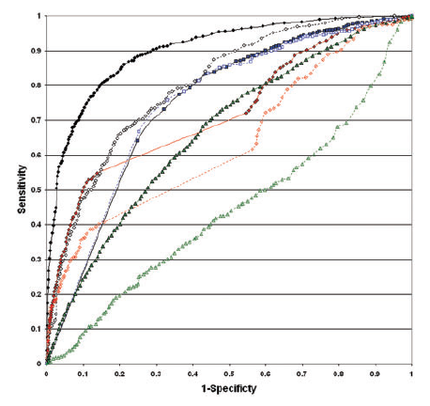
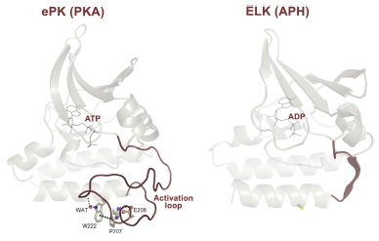
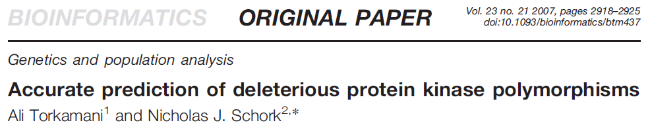
Functional Annotations: The Limits of Conservation
Torkamani, Kannan, Taylor, Schork. PNAS 105:9011-9016; 2008
Positions (residues/amino acids) of ~1000 disease causing variants in kinase proteins contrasted with the positions of ~1000 kinase variants not known to cause disease
Torkamani, Schork
SIFT
Review: Lahiry, Torkamani, Schork, Hegele. Nature Reviews Genetics 11; 2010
Cancer Predictions: Torkamani, Schork. Cancer Research 68; 2008

Slide 8


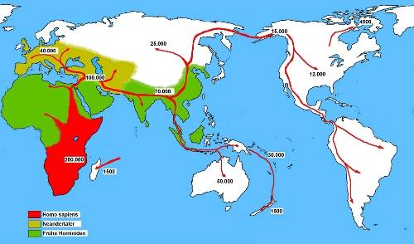
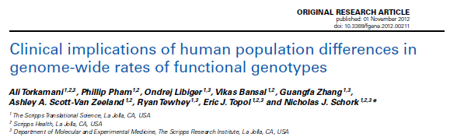
Available Whole Genome Sequences for Diversity Studies
http://archaeology.about.com/od/stoneage/ss/tishkoff_2.htm
CE=9
TS=4
JP=4
CH=4
MX=5
AS=5
GI=4
LW=4
YR=9
MK=4
We compared the number of type of DNA sequence variants between individuals from different ethnic groups
Implications for comparing and contrasting individual genomes

Slide 9
Population Differences in Variant Frequency and Type
----- Africa ----- Europe Asian Admixed
----- Africa ----- Europe Asian Admixed
----- Africa ----- Europe Asian Admixed
----- Africa ----- Europe Asian Admixed
Historical bottlenecks, migrations, founder effects, random inbreeding, lack of time for selective pressure to operate, etc. have left an imprint on contemporary global standing variation and homozygosity in non-African populations on a WGS functional variant basis (extends the work of Bustamante et al.)

Slide 10
Regression Analyses: All Functional Variant Types
Rate of Variant Type Per Genome: Negative Coefficient = Lower Rate; Positive = Higher Rate
Non-Africans differ from Africans in variant frequencies across virtually ALL functional variant categories
More variation in all functional elements in African genomes
More homozygous functional variation in non-African genomes

Slide 11
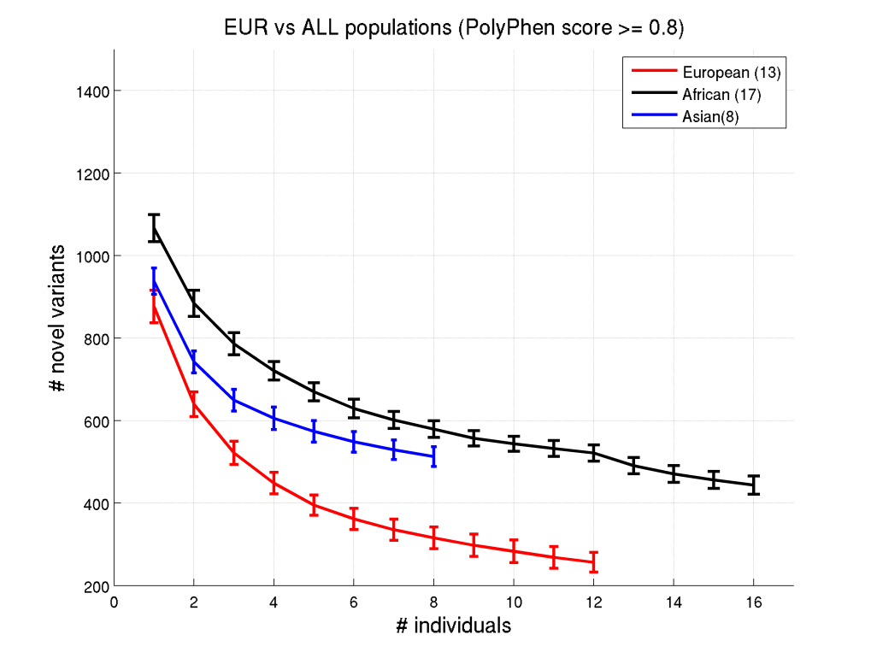
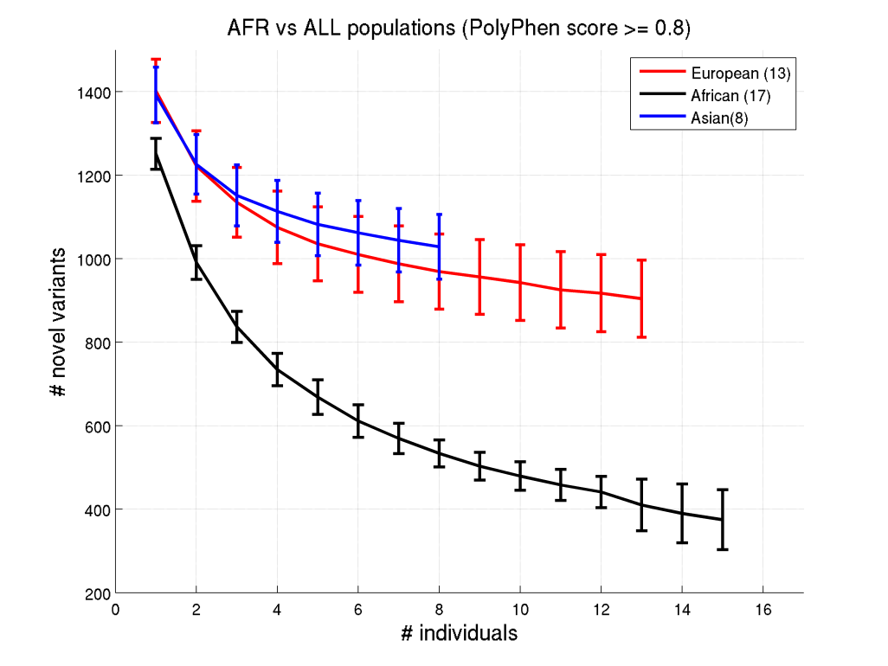
How Often Can One be Misled Using the Wrong Reference?
We ‘implanted’ known disease causative variants with Polyphen2 score > 0.8 in genomes
Determined the observed number of novel functional variants with different reference
Determining the novelty of a variant requires ancestry-appropriate reference genomes…
This has implications for clinical studies searching for variants for idiopathic conditons

Slide 12
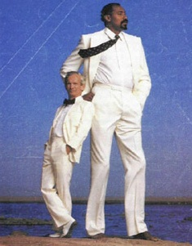
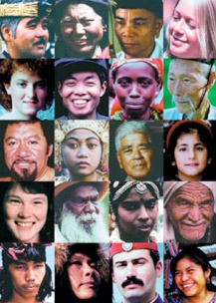
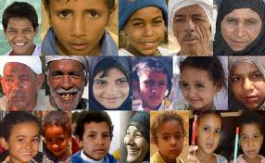
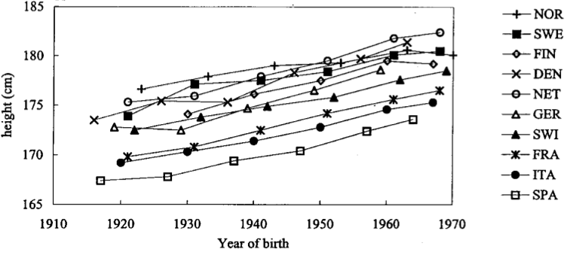
Genetic Differentiation Phenotypic Differentiation
Cavelaars 2000
Craniofacial Variation/Differentiation

Slide 13
Example low frequency populations
Example high frequency populations

Slide 14
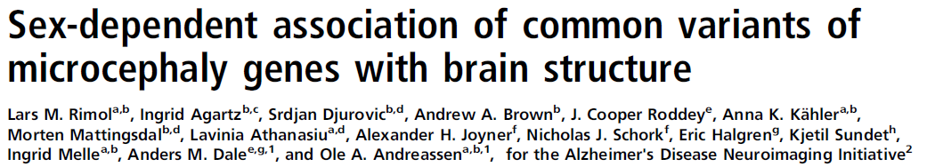
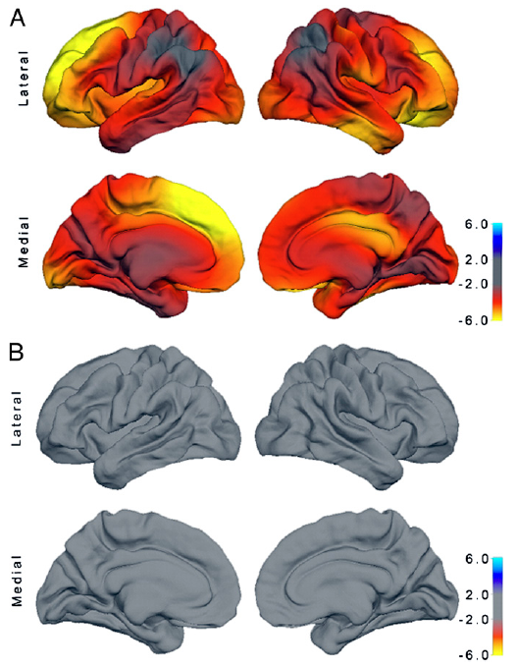
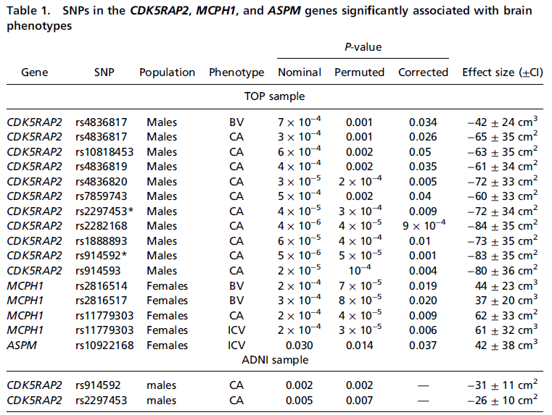

Slide 15
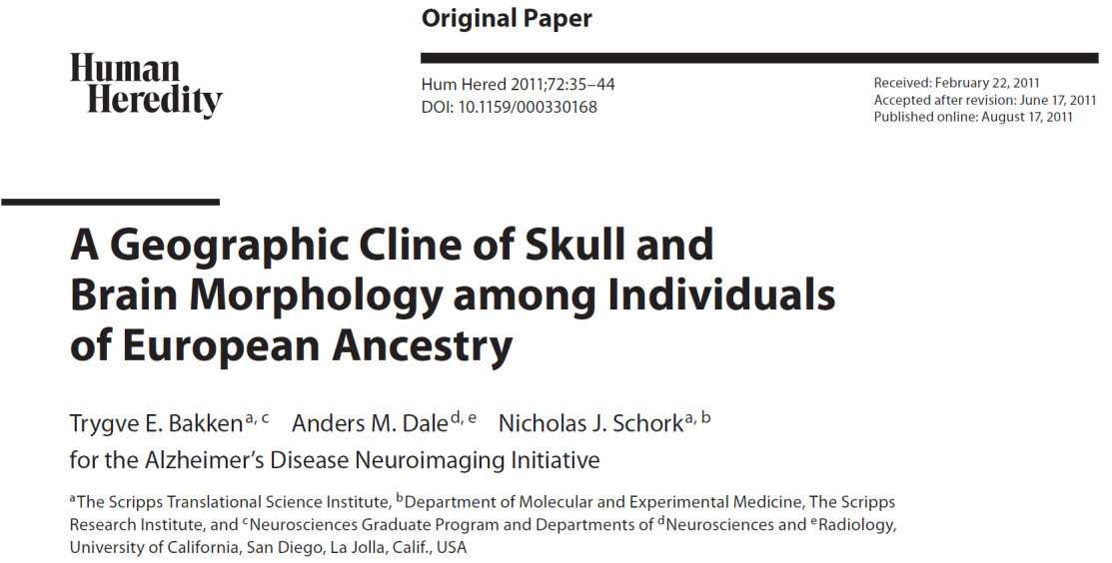
Hypothesis:
Brain size, as with skull size, shows variation consistent with historical migratory patterns in Europe (i.e., skull size and brain size are correlated but with what else?)
Two Data Sets:
Skulls obtained from individuals living in different European communities
Brain images from individuals whose ancestry was determined via genetic markers
Basic Analysis Strategy:
Correlate skull and brain size with major sources of population/individual genetic differentiation that reflect migratory patterns

Slide 16
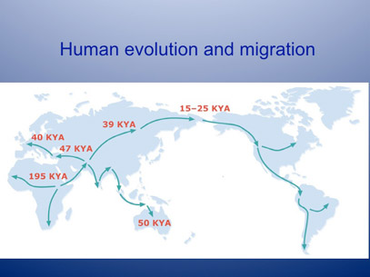
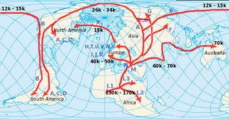
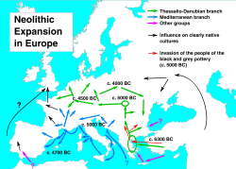
Historical Human Migrations and Settlements
European SE to NW Migratory ‘Axis’

Slide 17
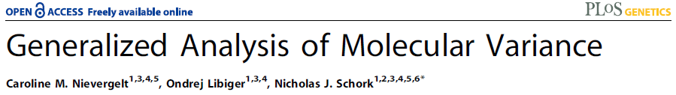
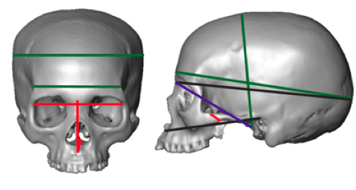
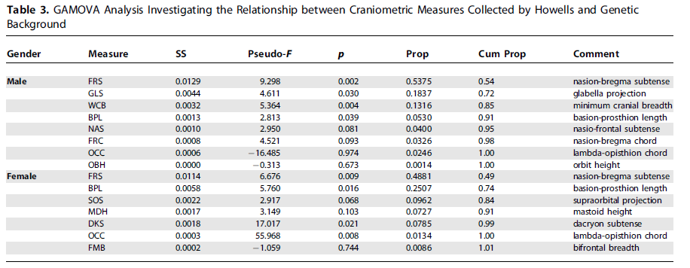
Genetic Background Correlates w/ Cranial Structure
The more similar the genetic background, the more similar the cranial features
Martinez-Abadias 2009

Slide 18
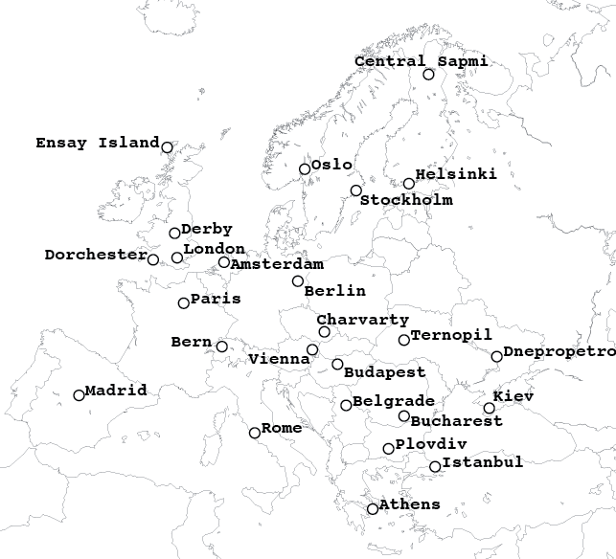
Cranial Morphology Spatially Structured in Europe
Martinez-Abadias 2009
1154 male skulls from 26 populations across Europe, N>10 per population
37 neurocranial and facial length measurements
85% of skulls had complete data (all had at least 34/37)
Bakken, Dale, Schork, ADNI (2011)

Slide 19
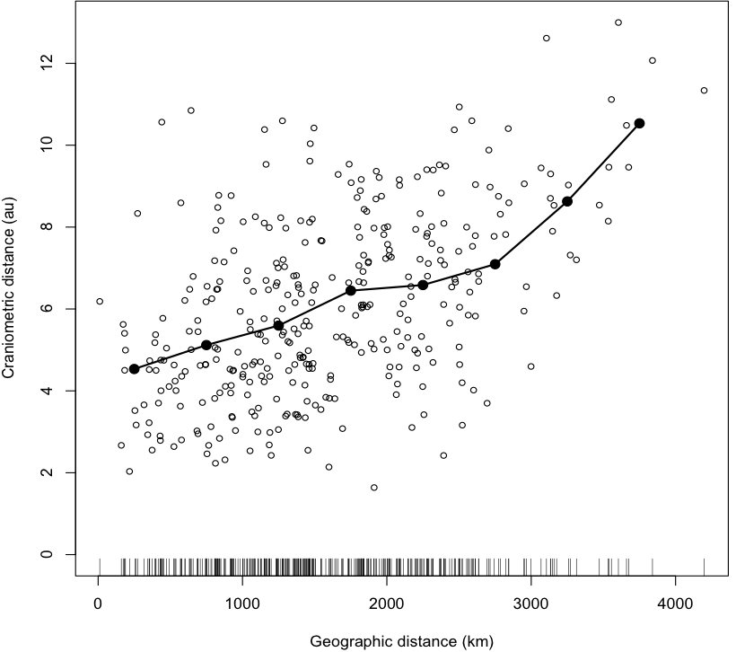
Analysis Suggests Variation Spatially Structured
Bakken, Dale, Schork, ADNI (2011)
Notes:
Mahalanobis distance

Slide 20
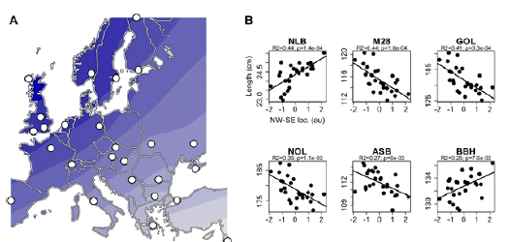
Several Cranial Lengths Vary Along NW–SE Axis
Bakken, Dale, Schork, ADNI (2011)
Notes:
Sokal1987 see an increase in cranial length (GOL) along this axis too

Slide 21
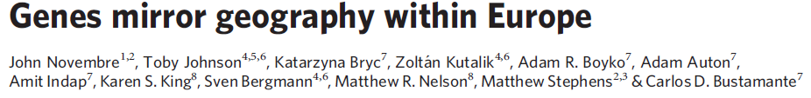
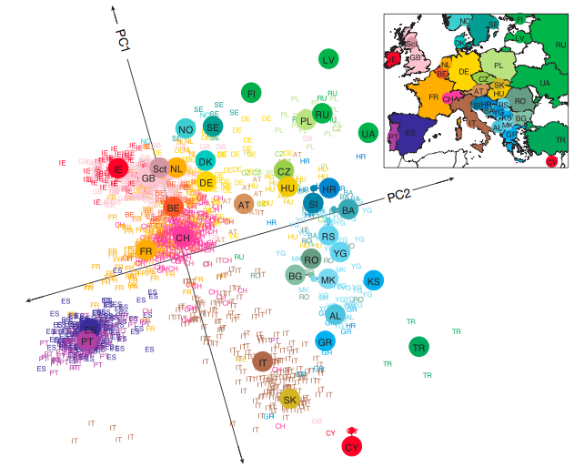
1387 European individuals
Self reported ancestry based
Affy 500k genotyping
Major axis of variation: NNW–SSE
Consistent with historical migration

Slide 22
ADNI Data for Brain Morphology/Ancestry Analysis
Ancestry Estimation:
626 Individuals with MRI phenotypes
PLINK33 software used to estimate ancestry
34 European reference populations from POPRES, HGDP, and HapMap
59,908 SNPs after filtering based on quality and linkage disequilibrium
NW–SE Genetic Admixture Assessment:
project rotated principal components onto a 45° line running NW-SE
NW–SE Admixture was Tested for Association With:
12 brain region summary measures
cortical area in 66 regions
cortical area across the surface of the brain
univariate linear models controlling for sex, age, height, weight, BMI, and
neurological diagnosis.
Bakken, Dale, Schork, ADNI (2011)

Slide 23
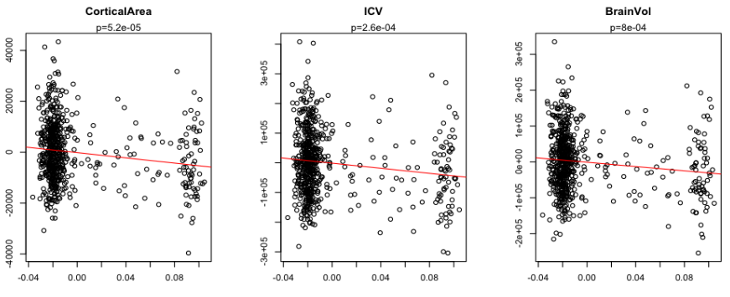
NW–SE Admixture Explains Small Variation in Brain Measures Independently of Height
ICV
Cortical Area
p = 2.5e-4
p = 5.2e-5, R² = 0.03
NW
SE
NW
SE
Covariates: Age, sex, diagnosis, height, BMI (these effects were eliminated!)
No association with: hippocampal volume, cortical thickness, cerebellar volume
Bakken, Dale, Schork, ADNI (2011)

Slide 24
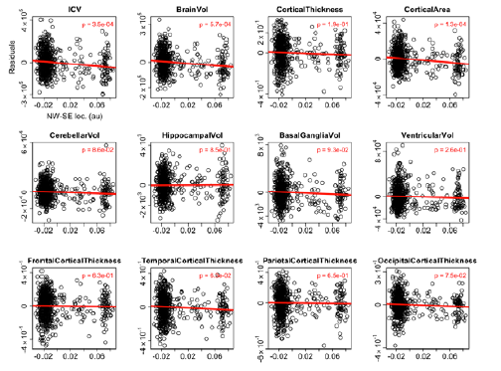
NW–SE Admixture Explains Small Variation in Brain Measures Independently of Height
Bakken, Dale, Schork, ADNI (2011)

Slide 25
Anterior Shift in Cortical Areas Along NW–SE Axis
Hemi | Lobe | Region | P-value
R | Frontal | lateralorbitofrontal | 1E-06
R | Temporal | superiortemporal | 2E-06
R | Frontal | rostralmiddlefrontal | 5E-05
R | Occipital | lateraloccipital | 6E-05
L | Temporal | superiortemporal | 8E-05
L | Cingulate | rostralanteriorcingulate | 1E-04
R | Frontal | caudalmiddlefrontal | 1E-04
L | Frontal | superiorfrontal | 2E-04
L | Frontal | lateralorbitofrontal | 2E-04
R | Temporal | transversetemporal | 2E-04
L | Frontal | parsopercularis | 3E-04
L | Occipital | lateraloccipital | 4E-02
R | Cingulate | rostralanteriorcingulate | 2E-01
Bakken, Dale, Schork, ADNI (2011)

Slide 26
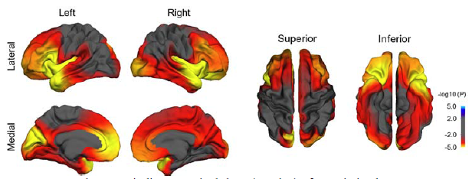
Frontotemporal Regions Are Most Affected by NW European Genetic Background.
Color maps that indicate nominal -log10(P-value) of association between NW–SE admixture and cortical area across the reconstructed cortical surface, while controlling for height, weight, BMI, age, sex, and diagnosis.
Bakken, Dale, Schork, ADNI (2011)

Slide 27

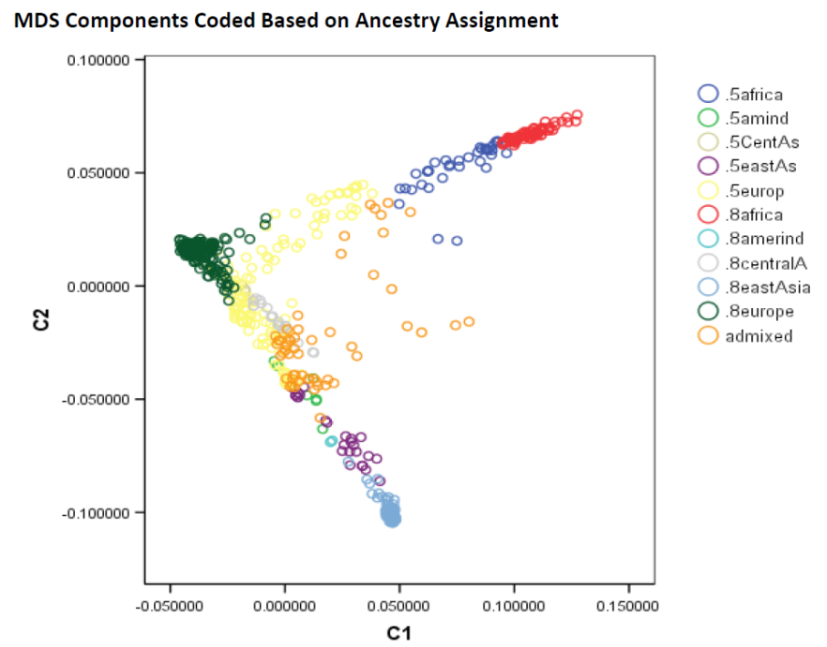
http://ping.chd.ucsd.edu/
The Influence of Ancestry on Pediatric Neuroimaging Phenotypes
Cinnamon S. Bloss, Ondrej Libiger, Ph.D., Burcu F. Darst, Andrew J. Schork, J. Cooper Roddey, Natacha Akshoomoff, David G. Amaral, B.J. Casey, Linda Chang, Thomas M. Ernst, Jean Frazier, Jeffrey R. Gruen, Walter E. Kaufmann, Brian Keating, Tal Kenet, Joshua M. Kuperman, David N. Kennedy, Sarah S. Murray, Stewart Mostofsky, Elizabeth R. Sowell, Peter Van Zijl, Terry L. Jernigan, Anders M. Dale and Nicholas J. Schork, Ph.D.
Pediatric Imaging, Neurocognition and Genetics (PING) Study: Large Pediatric Study
Focus is comprehensive neuroimaging, cognitive measures and GWAS data
Large (1200+) study involving individuals with a diverse ancestries
European, African, Native American, East, Asian, Oceanic, Central Asian
Libiger et al. manuscript in preparation

Slide 28
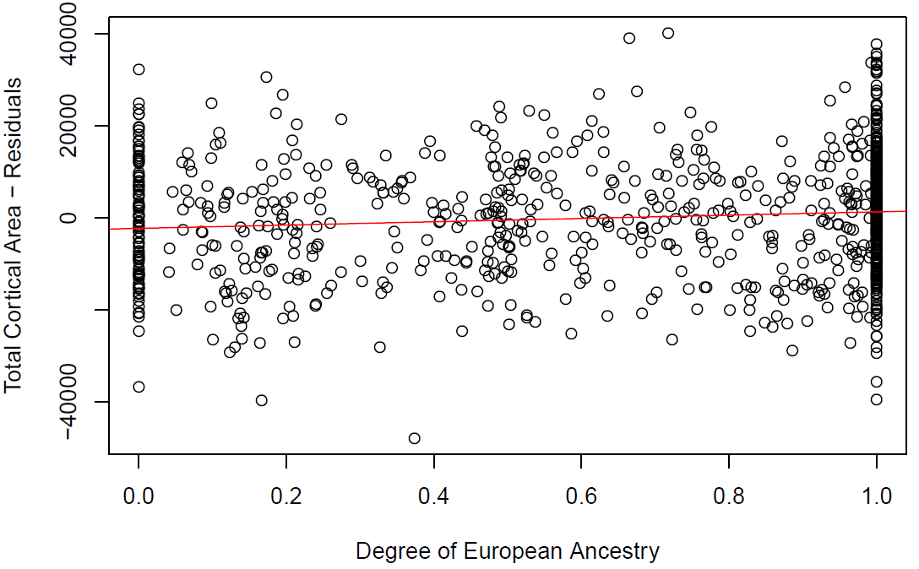
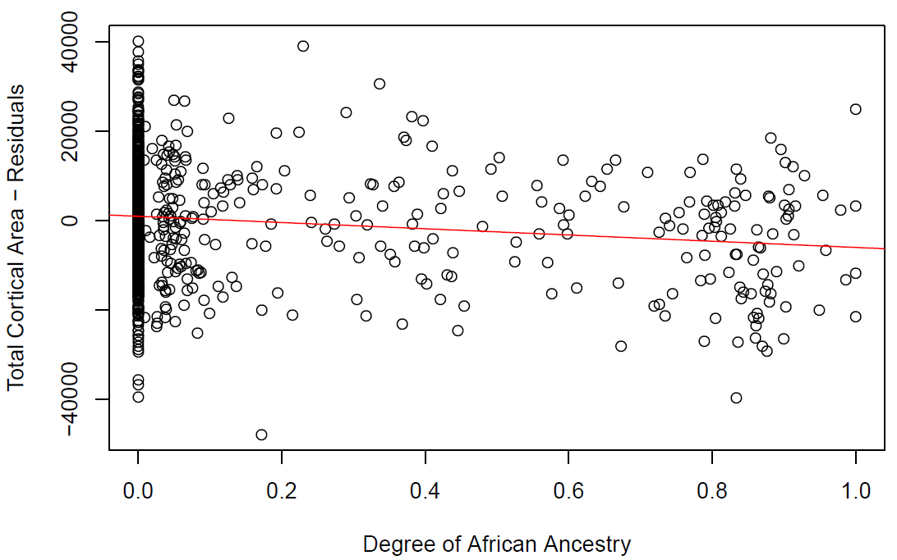
Correlations Between Degree of Admixture and Neuroanatomy
(Including and Excluding Non-Admixed Individuals; PING data)
Simple correlations: TCA vs. admixture
(Covariates: linear age, quadratic age, cubic age, sex, income and highest parental education and scanner (TCA, MCT and ICV))
GAMOVA results:
Africans (most divergent from others)
East Asians (next most divergent)
Native American (next most divergent)
European (next most divergent)
Central Asian (least divergent)
Residual genetic variation associated with cortical area = ~2% (p=0.009)
p<0.0007
p<0.0000006
Libiger et al. manuscript in preparation

Slide 29
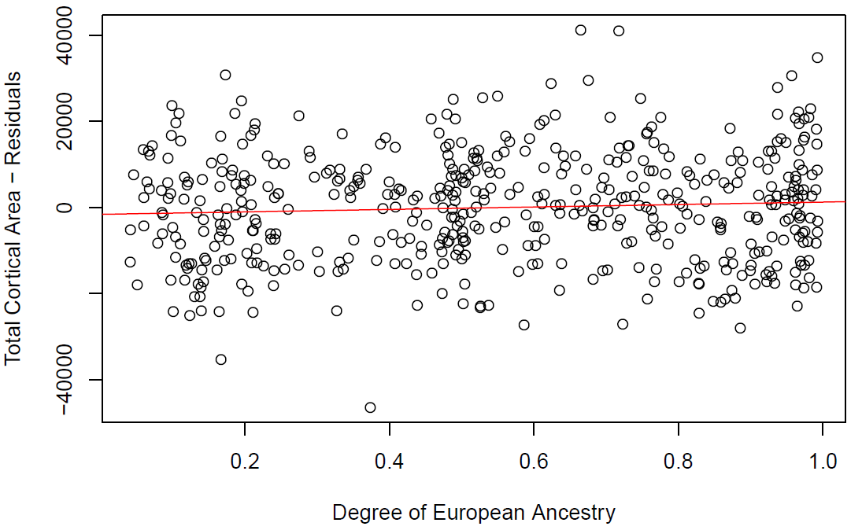
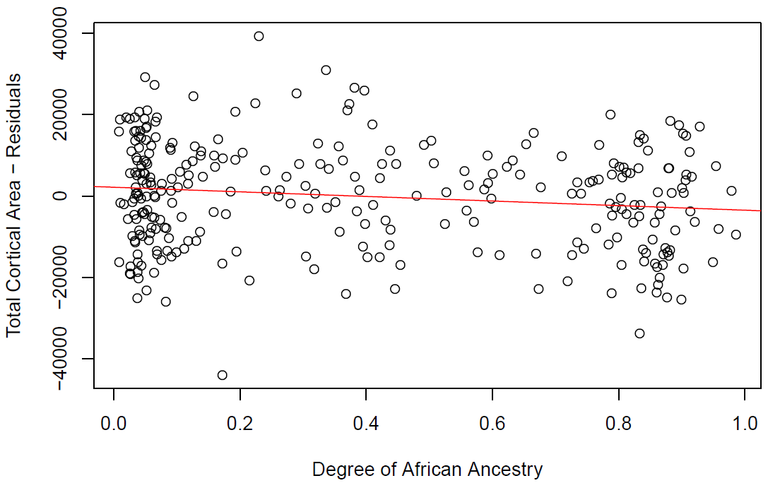
Correlations Between Degree of Admixture and Neuroanatomy
(Including and Excluding Non-Admixed Individuals; PING data)
Correlations with only admixed individuals:
No overt environmental differences between ‘pure’ groups
Environmental exposure would have to track with degree of admixture?
Multiple ancestries contributing to admixture make an environmental correlate unlikely
p<0.002
Libiger et al. manuscript in preparation

Slide 30
Correlations Between Degree of Admixture and Neuroanatomy
(Including and Excluding Non-Admixed Individuals; PING data)
Correlations likely influenced by a polygenic effect, not just environmental differences
Libiger et al. manuscript in preparation

Slide 31
The Implications of Ancestry for Neuroimaging-Guided Pediatric Diagnoses
Cinnamon S. Bloss, Ph.D.,*^{1,2} Ondrej Libiger, Ph.D.,*^{1,3} Burcu F. Darst, B.S.,^{1,2} Andrew J. Schork, B.S., ⁴ J. Cooper Roddey, Ph.D., ⁴ Natacha Akshoomoff, Ph.D.,⁴ David G. Amaral, Ph.D.,⁵ B.J. Casey, Ph.D.,⁶ Linda Chang, M.D.,⁷ Thomas Ernst, Ph.D.,⁷ Jeffrey R. Gruen, M.D.,⁸ Walter E. Kaufmann, M.D.,⁹ Tal Kenet, Ph.D.,¹⁰ David N. Kennedy, Ph.D.,¹¹ Sarah S. Murray, Ph.D., ^{1,3} Elizabeth R. Sowell, Ph.D.,¹² Anders Dale, Ph.D., ^{¶,4} Terry L. Jernigan, Ph.D., ^{¶,4} & Nicholas J. Schork, Ph.D., ^{¶,1,3,13}
Presented at the 2012 UCI International Imaging Genetics Conference
Figure 2: Age and sex adjusted distribution of total cortical area and mean cortical thickness in individuals with various genetic ancestry.
Libiger et al. manuscript in preparation

Slide 32
Population Stratification and False Positive Associations
Population 1 Population 2
-
-
-
+
-
+
+
+
+
-
-
+
-
-
+
+
-
+
+
+
-
+
-
+
-
-
+
+
-
+
-
-
+
+
-
-
-
-
+
-
+
-
-
+
+
+
+
-
-
+
Diseased = Shaded: ; Non-Disease = Non-Shaded:
Differential frequency of the +/- alleles between the populations
+
+
+
+
+
+
-
-
-
-
-
-
Cases Controls
(+: 6/6) (+: 0/6)

Slide 33
The Transmission Disequilibrium Test (TDT)
TA
AA
The TDT tests the frequency with which a particular allele is transmitted to an affected offspring from a heterozygous parent (normally 50% probability)
The TDT requires no control group (the untransmitted allele is thus the ‘control’)
TA
By not requiring a control group, the TDT avoids the problem of stratification for genetic association studies
In addition, the TDT avoids the need to identify appropriate controls
However, the TDT does not easily accommodate epidemiologic investigations involving multiple genetic and non-genetic factors or interactions

Slide 34
Stratification: No Longer an Issue?
One can genotype the individuals in an association analysis at many, many loci. The genotype information can then be used to essentially ‘cluster’ the individuals
The resulting cluster group memberships can then be used as ‘covariates’ in a genetic association analysis to control for potential stratification or heterogeneity
Alternatively, to control for heterogeneity, one might consider sampling from an isolated population with a restricted gene pool
The use of cluster membership as covariates is akin to standard epidemiologic practice of controlling for confounders, such as race, although the practice of using race as a surrogate for genetic background is problematic due to admixture
Admixture (i.e., the mating of individuals from different populations) can be accommodated via ‘Ancestry Informative Markers’ or ‘AIMs’

Slide 35
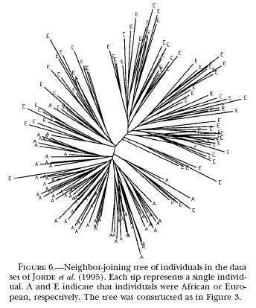
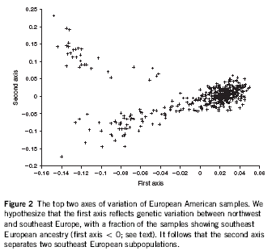
Example Methods Used to Sort Out the Genetic
Backgrounds of Individuals in a Sample

